Slide 1
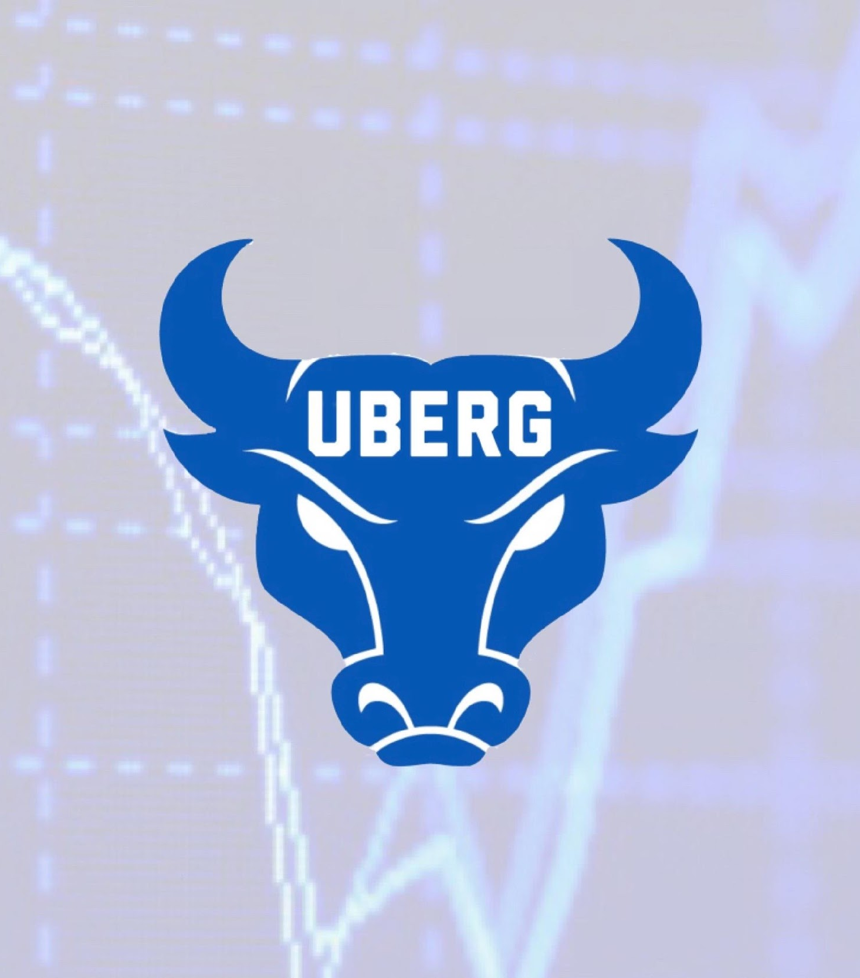
UB Equity Research Group
LinkedIn + Resume Workshop, Networking

Slide 2
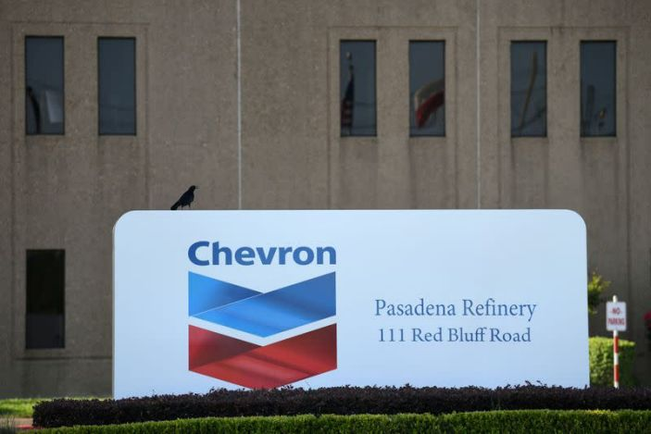
Market Current Event of the week!
“Green groups file FTC complaint against Chevron over climate claims”
-Three environmental groups filed a false advertising complaint against Chevron with the Federal Trade Commission on Tuesday, alleging that the U.S. oil major has overstated its investment in renewable energy and actions to curb greenhouse gas emissions.

Slide 3
LinkedIn: What is it?
A social network that focuses on professional networking and development.
A platform to display your resume, search for new jobs, and enhance your professional reputation. (posting and interacting with other people)
A more formal version of Facebook
You can personally reach out to anyone on LinkedIn, even if you’ve never met them. (see example)
Do not try to get an internship on LinkedIn the first time you talk to a recruiter. Get to know them first.

Slide 4
Bad VS Good examples of LinkedIn Message
Bad
Hello Greg,
I hope you are doing well.
My name is Connor Mulholland and I am currently a senior at the University at Buffalo. I saw your post about the recent endowment you made to the School of Management and thought it was remarkable! I imagine many things have changed here since your graduation, but you’ll be glad to know the school of management is carrying on as strong as it ever has.
I have been following your company for some time now, and wanted to finally reach out and connect with you. As a graduating senior who is searching for a job in the financial services industry, I figured there’d be no better place to look than XYZ firm.
If your schedule permits it, I would love to chat about your experience at XYZ and how I would be a great fit as an employee. I have attached my resume below for your review, and would be more than happy to discuss it on a quick call.
Thank you so much for your time, and I hope to speak with you soon.
Stay safe and be well,
Connor Mulholland
Hello,
I am messaging you because you went to my college and I need a job. Is your company hiring?
Thanks.

Slide 5
Example of an opening LinkedIn statement?
Short, precise and to the point.
I highlight an achievement of mine and how I use my knowledge to help others...etc
I also shed light on how I am still working towards bettering myself.
Humility is key. Do not come off arrogant and cocky.
At the end, I shortly say how I am currently looking for a solid platform to build my financial career. This could lead to a possible opportunity in the future or for a conversation about employment opportunities.
This is just an example. I am not saying you need to follow my style of writing. -Christian

Slide 6
Why you should be on it?
LinkedIn is an online version of your resume. (autonomous applying)
Recruiters or even connections come to you. (Simple)
Expand your professional network further than you would’ve ever thought. (Ex. Christians profile, 500+ connections at the click of a button)
Allow yourself to set yourself apart from the crowd. (You vs. someone who doesn’t have account).
It only takes roughly 30 minutes to set up a complete account. (The more time you put into it, the better it will be….)
Aside from networking, there are some very interesting reads and articles that you have free access to.
The account is free to set up.
Easy access….app or google.
UBERG will be getting professional headshots for members, included in dues.

Slide 7
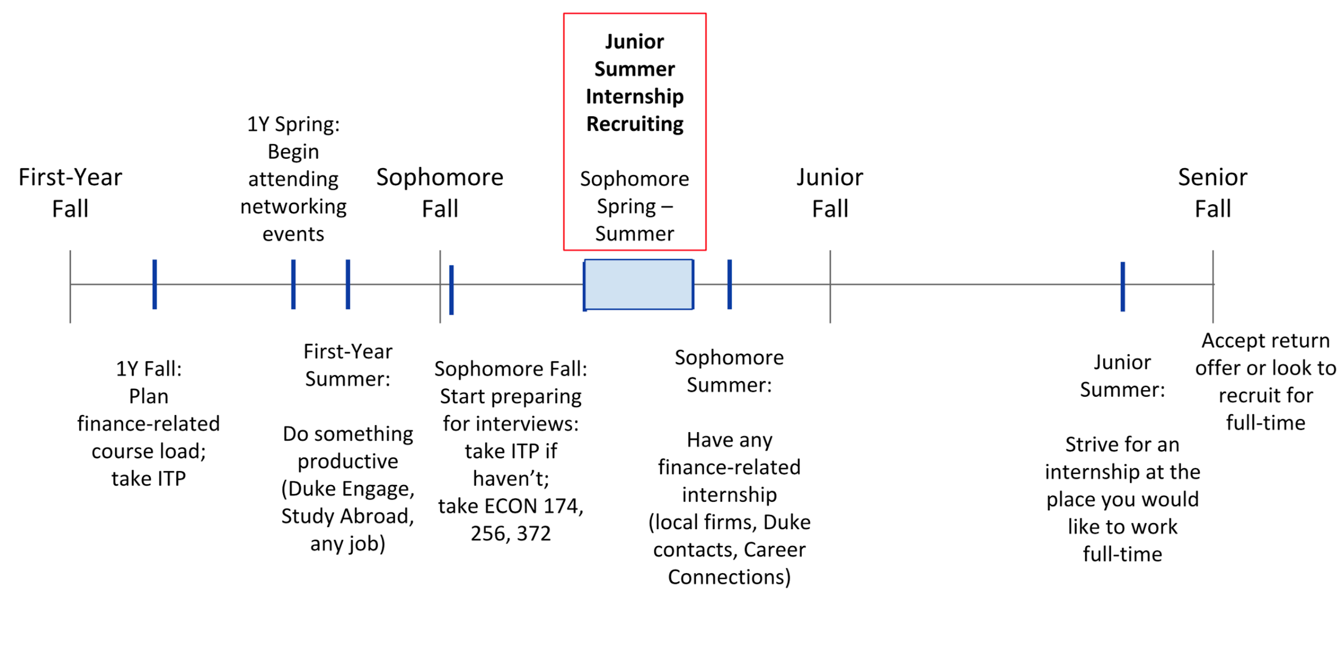
Start Early!

Slide 8
Internship Advice
Finding an internship can be a full time job.
Do not be picky and be flexible (Apply even if not finance related ex.. operations)
Start Early (Start this week if you are looking for a summer internship)
Reach out to small firms as well. Don't limit yourself to Fortune 500 companies, they are more competitive.
Ask/express interest in working for the company full time after you’ve completed internship.

Slide 9
Interview Preparation
Dress to impress. A fitted suit goes a long way. (black/dark suit, Men: solid color tie)
Do your homework/prepare! (Research the company, its products, how it makes money, even research the CEO. (Example: Jason Trennert; book)
You do not want to be caught off guard when they ask you about their company.
Write out Practice interview questions such as behavioral questions and type out answers to prepare. (e.g. Name a time when…)
Be confident. (CRUCIAL)
**Find out who will be interviewing you. It is totally acceptable to email the employer and ask this!**

Slide 10
Interview Preparation
Most questions will be behavioral usually, but can be also technical. (Examples?)
Know your technicals. (Don’t say you know Python, but you really don’t...etc)
Sign up for practice interviews to get more comfortable, when the time comes for an internship/Job.
Firm handshake when you meet the interviewer
Make sure to maintain good eye contact during the interview.
ALWAYS ask at least 3-5 questions after the interview.

Slide 11
Aspects of a Great Resume & How to Stand Out
High GPA (depends where applying)
Don’t list your GPA if it isn’t strong
Internships ( Ideally 1-3 prior to graduation)
Work experience
Club & extra curricular activities
Learn technical skills. (e.g. Excel, programming etc.)
Volunteering
One page

Slide 12
Aspects of a Great Resume & How to Stand Out
Cater your resume to your strengths.
Leadership, leadership, leadership
Use strong action words such as Created, Supervised, Executed and Analyzed
Don’t be afraid to go to the internet for help.
Applicable for any job no matter what field
Try to have as little free space as possible while keeping the page organized. Do not beat around the bush.
Try to have as many numerical values as possible, included in your sentence
**Make sure you can talk thoroughly about any/every topic on your resume**

Slide 13
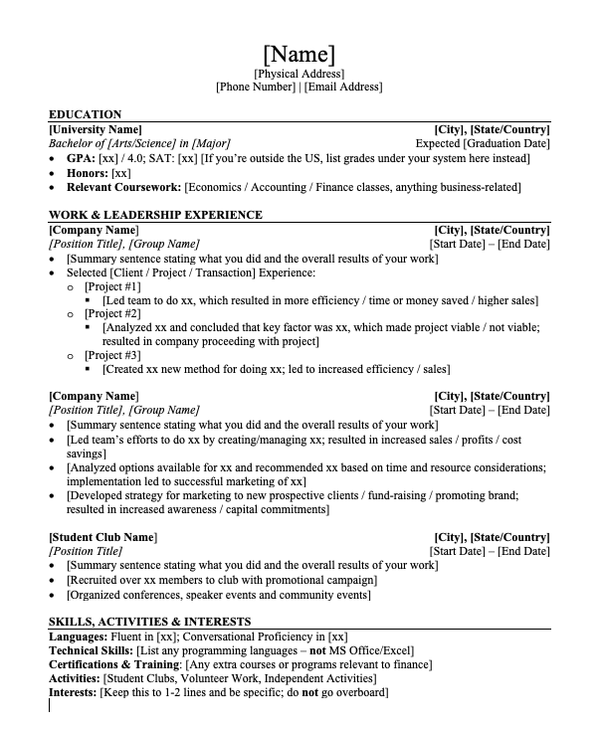
Resume Template
Link to word doc of this template attached:
https://www.mergersandinquisitions.com/free-investment-banking-resume-template/
PS. You want to use a PDF version of your resume when you submit it.

Slide 14
Cover Letters
Writing a cover letter when applying to jobs and internships is a way to make yourself stand out.
Personalize the cover letter and address someone within the firm
Focus on qualifications, how you can contribute, avoid using the word I and cater the cover letter to the employer
Provide proof. Example: “ I am proficient in excel. This is evident through my internship at XYZ company where I worked with databases where I did functions like V-lookup, created pivot tables and more”
Use descriptive adjectives and action verbs.

Slide 15
Applying to Jobs/Internships
Try to apply directly on the employer’s website
LinkedIn easy apply has a very low success rate
Referrals make a HUGE difference
Include a cover letter when possible
Letter(s) of reference

Slide 16
LinkedIn Links
@ Taylor Lasomser www.linkedin.com/in/taylorlasomser
@ Chris Salvatore https://www.linkedin.com/in/chrissalvatore66/
@ Varun Singh www.linkedin.com/in/varunsingh561
@Connor Mulholland https://www.linkedin.com/in/connormulholland/
@Max Crummy https://www.linkedin.com/in/max-crummy-1a5222190/
@Zach Foster https://www.linkedin.com/in/zmfoster/
@Katherine Mariano https://www.linkedin.com/in/katherine-mariano-ub22/
@Aiden Herron https://www.linkedin.com/in/aiden-herron/
@Thomas Dias https://www.linkedin.com/in/thomasjodias/

Slide 17
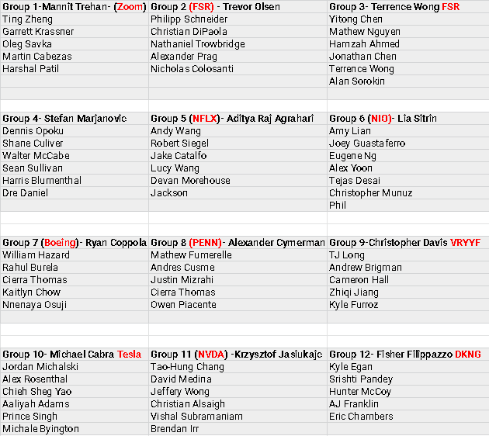
Updated Groups

Slide 18
Research and Presentation- Make it your own
Assess the skill level of your group
Challenge yourself
Play to your strengths
Today you can:
Divide research amongst members
Find analyst reports on the companies
Some find “Buy” ratings and others find “Sell” ratings
Compare the arguments for each side
Use the tailwinds/headwinds to begin a SWOT analysis
Competitive analysis- What separates the business from competitors

Slide 19
Questions?

Slide 20
THANK YOU FOR COMING!
Stay In Touch
IG & TWITTER: UBEQUITYRESEARCH

