Slide 1
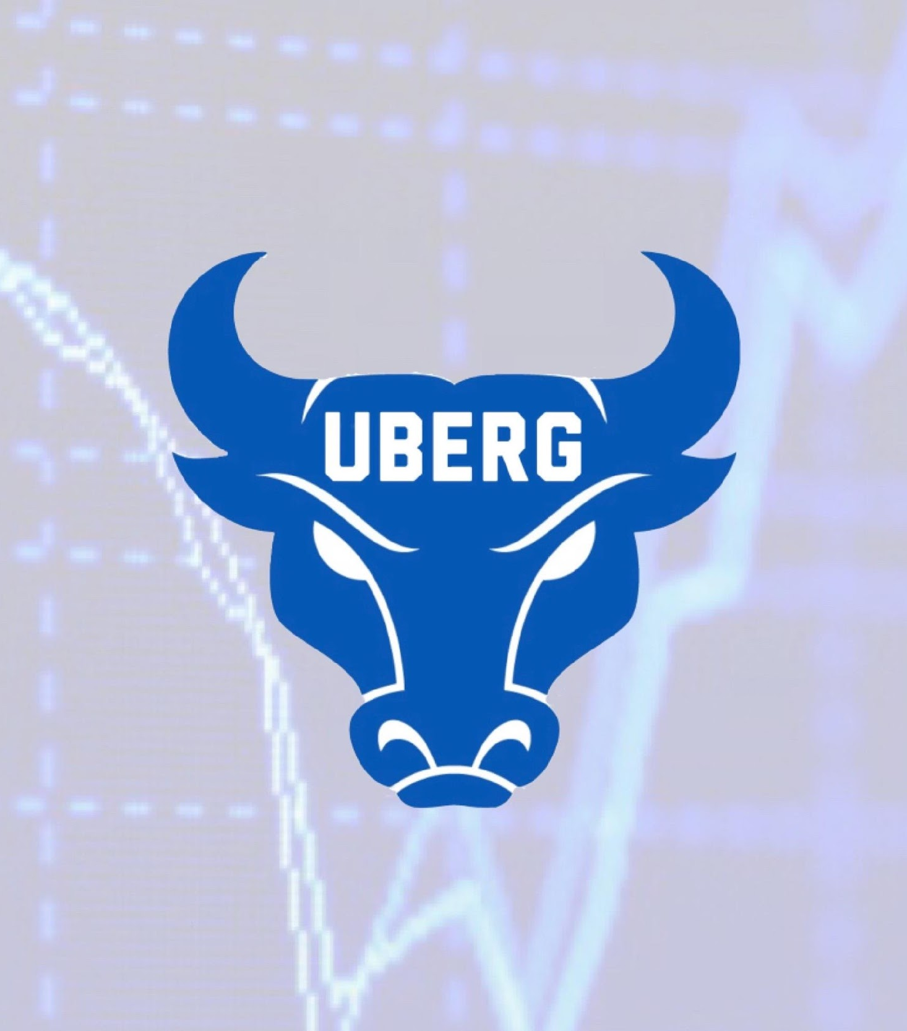
UB Equity Research Group
Options trading and other trading basics

Slide 2
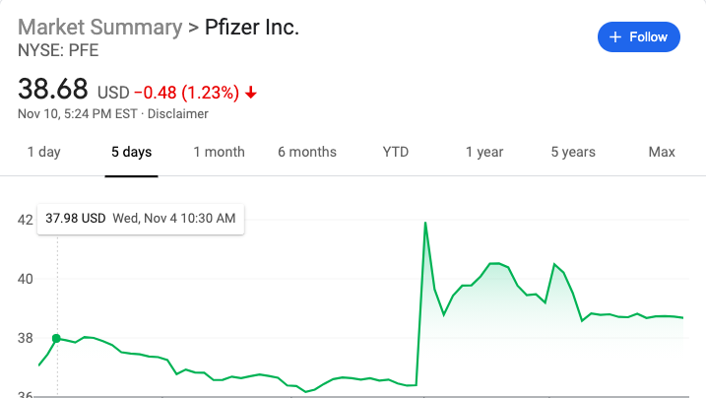
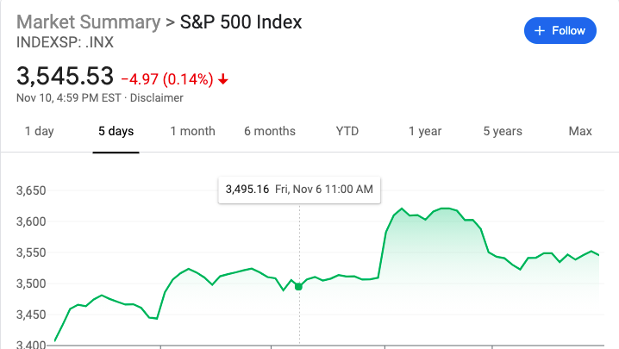
Current event
Pfizer - Covid Cure?
American multinational pharmaceutical corporation.
Some of their most popular drugs include Advil, Lyrica, Robitussin and Viagra.
Have received criticism for price related issues in the past - Epipen/Viagra.
This week they have announced that their Covid-19 vaccine is 90% effective
Off the news we see a big spike in the stock price of Pfizer followed by a correction, and this was seen all around the market.
So we can conclude that investors are happy with the news and are excited to ditch their masks.

Slide 3
What is Options Trading?
An option is a contract giving the buyer the right, but not the obligation, to buy (in the case of a call) or sell (in the case of a put) the underlying asset at a specific price on or before a certain date.
Price is per 100 Contracts
Strike Price
Expiration
In the money (ITM)
Out of the money (OTM)
Time decay (Theta)

Slide 4
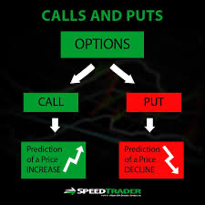
Calls, Puts, and more
Calls- a financial contract that gives the right but not the obligations to buy a stock
Remember that calls and puts are decaying assets
Puts- a financial contract that gives the right but not the obligation to sell a stock

Slide 5
Iron Condor/Butterfly

Slide 6
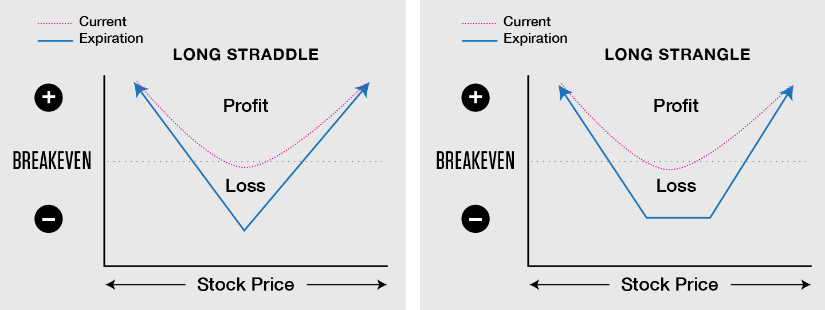
Straddle/Strangle
Straddles and strangles are both options strategies that allow an investor to benefit from significant moves in a stock's price, whether the stock moves up or down.

Slide 7
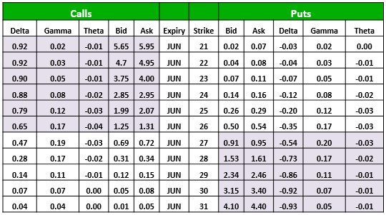
Understanding the Options Chain
Understand bid and ask
Find the Expiration
Find the strike price
Understand the shaded area
Understand the greeks

Slide 8
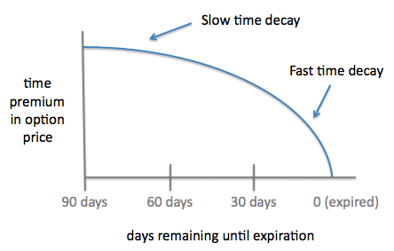
The Greeks
Delta: Shows how much the price will move for every dollar the stock moves (constantly changing)
Theta: The rate at which time decay affects an option
Gamma: The rate at which delta will change

Slide 9
Different types of Traders or Trading Strategies
Scalp trading
Momentum Trading
Technical Trading
Fundamental Trading
Swing Trading
Day Trading

Slide 10
Technical Trading
A Technical Trader focuses on charts and graphs.
They analyze lines on stock/index graphs for signs of convergence or divergence.
Convergence- When the indicator and price move in the same direction.
Divergence- When there is a disagreement between the indicator and the price. Indicates that something is changing rapidly

Slide 11
Fundamentals Trading
Is a method of Trading, where a trader focuses on company-specific events to determine which stock to buy and when to buy it.
“Trading on Fundamentals” is more of a buy-and-hold strategy, then a day trade (buy and sell in one day) strategy.
Fundamental Analysis- is a method of measuring a securities intrinsic value by examining related economic or financial factors.

Slide 12
Swing Trading
Swing Traders are Fundamental or Technical Traders who hold their positions for longer than a single day.
Swing traders usually hold their stocks for a period of a couple of days or from 2 to 3 weeks.

Slide 13
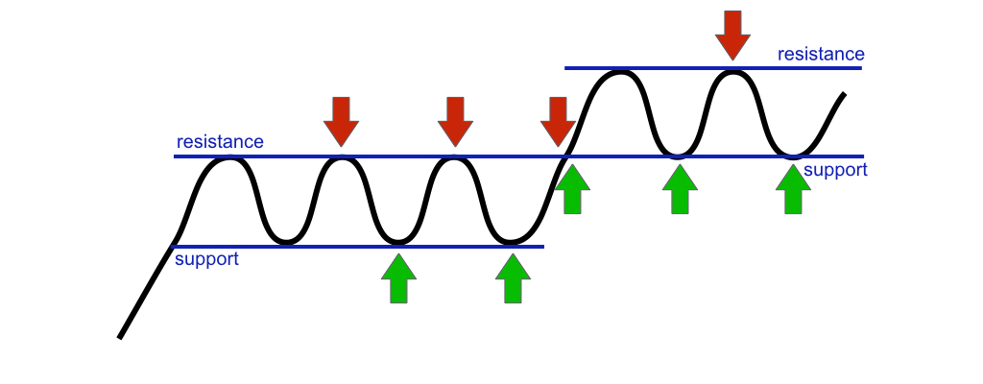
Support and Resistance
Support- Where buyers will be present
Resistance- Where sellers will be present
Resistance becomes support after it has been broken
Support becomes resistance after it has been broken
For those following the markets today, SPY has bounced off a strong resistance level at ~$280

Slide 14
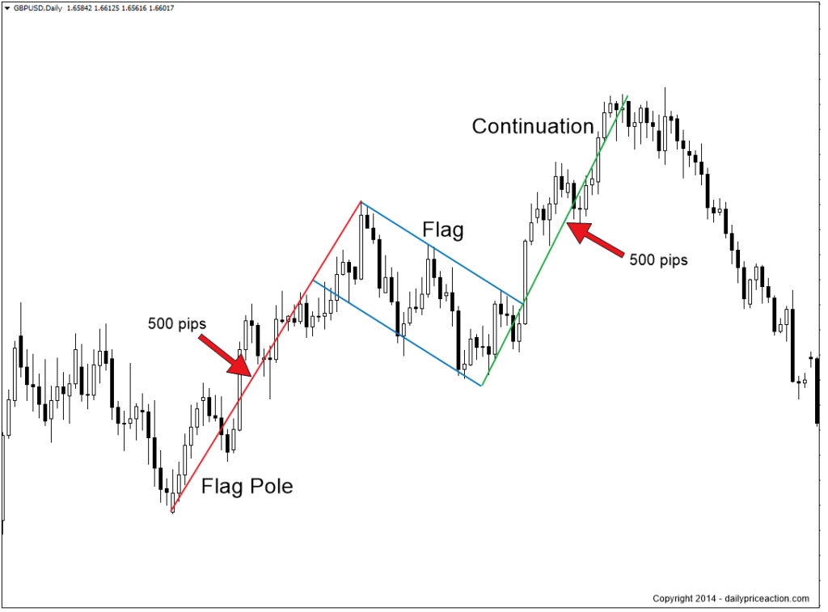
Common Candlestick Patterns- Bull Flag
A bull flag is a common continuation/consolidation pattern that indicates a continued uptrend. This pattern consists of a “flag pole” or a strong uptrend, followed by a brief period of consolidation (the flag) and then a strong upside breakout.
Traders will often say that a stock is “flagging,” meaning that they expect further upside.

Slide 15
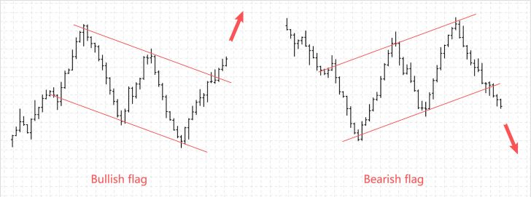
Common Candlestick Patterns- Bear Flag
A bear flag is just the opposite of a bull flag. This pattern consists of a “flag pole” or a strong downtrend, followed by a brief period of upward consolidation (the flag) and then a strong downside breakout.
As you can see on the left, the bullish and bearish flag patterns are simply inverted versions of one another.

Slide 16
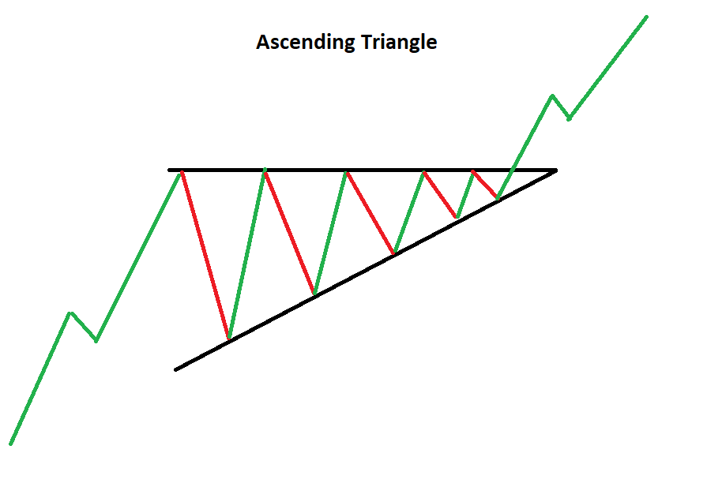
Common Candlestick Patterns- Ascending Triangle
An ascending triangle os one of the most reliable bullish technical trading patterns. This pattern is classified by higher lows, and similar highs, indicating that an equity wants to move higher but is struggling to break resistance.
This pattern shows a resumption of an uptrend when the top resistance line is broken and held.

Slide 17
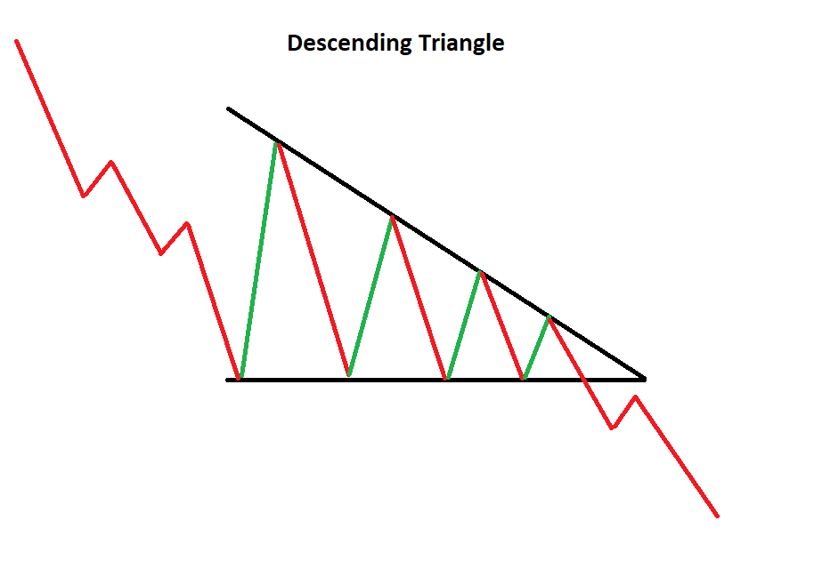
Common Candlestick Patterns- Ascending Triangle
An descending triangle os one of the most reliable bearish technical trading patterns. This pattern is classified by lower highs, and consistent lows, indicating that an equity wants to move lower but is struggling to break through support.
This pattern shows a resumption of an downtrend when the support line is broken and held.

Slide 18
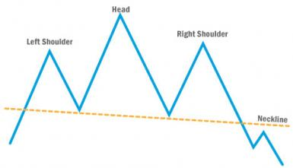
Candlestick Patterns- Head and Shoulders
A head and shoulder pattern is a reversal pattern, meaning that it indicates an inversion in price action. This specific pattern is a bearish pattern, meaning that it indicates the beginning of a downtrend.
When trading using a head and shoulders pattern, it is best to look for an entry when the neckline is broken to the downside and held.

Slide 19
Have some free time? Learn more!
Watch this video to learn some of the basics of technical analysis or TA.
https://www.youtube.com/watch?v=rlZRtQkfK04

Slide 20
THANK YOU FOR COMING!
Stay In Touch
IG & TWITTER: UBEQUITYRESEARCH

