Slide 1
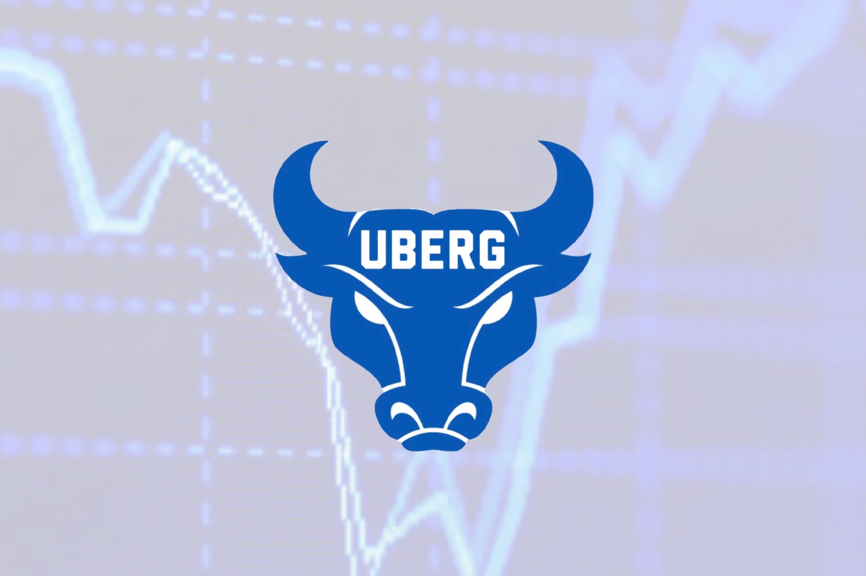
UB Equity Research Group
Earnings Season Overview

Slide 2
Important Updates
Interviews taking place in next two weeks
Check email
Anyone start course yet?
No Meeting on Nov. 24th
Equity Research Reports!
Message us if you need a company to research

Slide 3
Current Event
S

Slide 4
Outline
What is an earnings call?
10-Q, 10-K
Results (Numbers)
EPS, Revs
Results (Guidance)
What to listen for

Slide 5
Common Terminology
EPS- Earnings Per Share
Revenues- Sales over the period
EBITDA
Guidance

Slide 6
Investor expectations
Current price action?
Up or down in recent weeks?
Price trending up: Expecting a strong report
Price trending down: Expecting a weaker report

Slide 7
Earnings Reports, 10-Q, 10-K
10-Q
Quarterly Results
Profits
Revenues
Financial Positioning
Both contain I/S, B/S, Statement of cash flows
10-K
Yearly Results
Profits
Revenues
Fiscal Calendar End
More detail
Current positioning
SWOT, Competition

Slide 8
Example of 10-Q

Slide 9
Example of 10-K

Slide 10
Results to watch for
EPS- Earnings Per Share
Revenues

Slide 11
What they mean?
EPS Beat/Miss
Revenues Beat/Fall short

Slide 12
Guidance
M

Slide 13
The Earnings Call

Slide 14
Market reaction
T

Slide 15
Overview
10-K vs. 10-Q
Common Terminology
What to look for
What to listen for
Market reaction

Slide 16
Kahoot!

Slide 17
Questions?

Slide 18
THANK YOU FOR COMING!
Stay In Touch
IG & TWITTER: UBEQUITYRESEARCH

