Slide 1
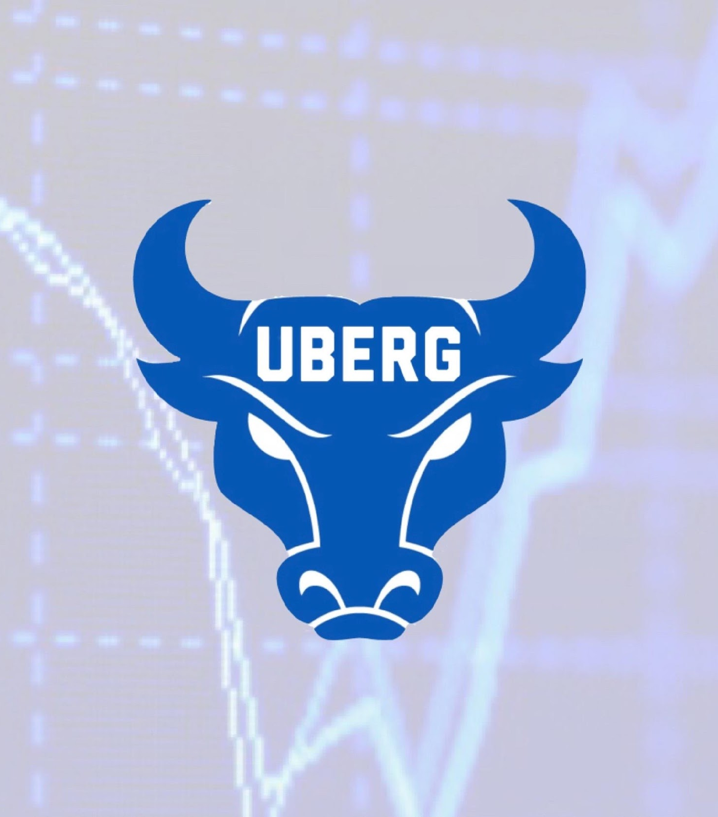
UB Equity Research Group
Options trading and other trading basics

Slide 2
Reminder- Member fees due tonight!
$30 via https://www.ubequityresearchgroup.com/about-1 or by sending $30 to @UBERG on Venmo with your full name and UB email in the description

Slide 3
What is Options Trading?
An option is a contract giving the buyer the right, but not the obligation, to buy (in the case of a call) or sell (in the case of a put) the underlying asset at a specific price on or before a certain date.
Price is per 100 Contracts
Strike Price
Expiration
In the money (ITM)
Out of the money (OTM)
Time decay (Theta)

Slide 4
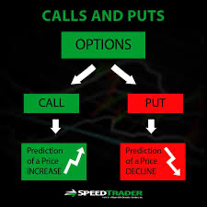
Calls, Puts, and more
Calls- a financial contract that gives the right but not the obligations to buy a stock
Remember that calls and puts are decaying assets
Puts- a financial contract that gives the right but not the obligation to sell a stock

Slide 5
Iron Condor/Butterfly

Slide 6
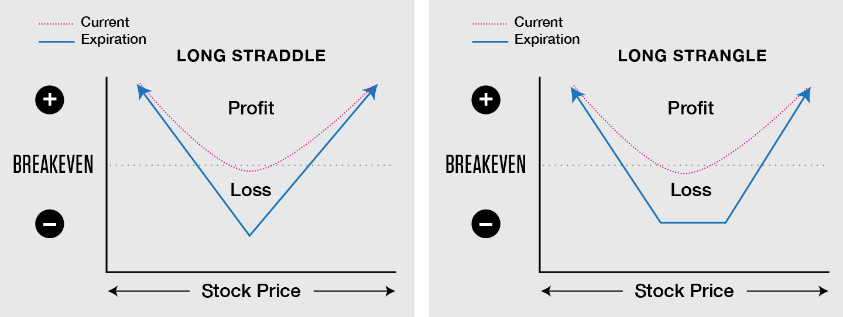
Straddle/Strangle
Straddles and strangles are both options strategies that allow an investor to benefit from significant moves in a stock's price, whether the stock moves up or down.

Slide 7
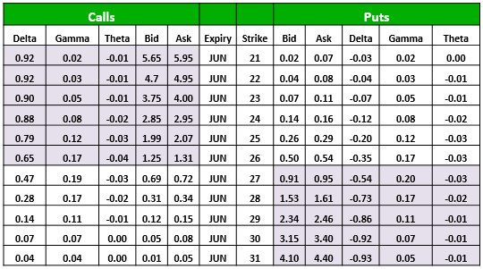
Understanding the Options Chain
Understand bid and ask
Find the Expiration
Find the strike price
Understand the shaded area
Understand the greeks

Slide 8
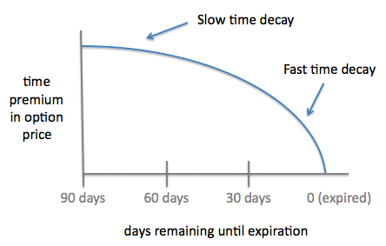
The Greeks
Delta: Shows how much the price will move for every dollar the stock moves (constantly changing)
Theta: The rate at which time decay affects an option
Gamma: The rate at which delta will change
Vega- Change in implied volatility

Slide 9
Have some free time? Learn more!
Watch this video to learn some of the basics of technical analysis or TA.
https://www.youtube.com/watch?v=rlZRtQkfK04

Slide 10
Advanced options strategies
https://www.investopedia.com/trading/options-strategies/

Slide 11
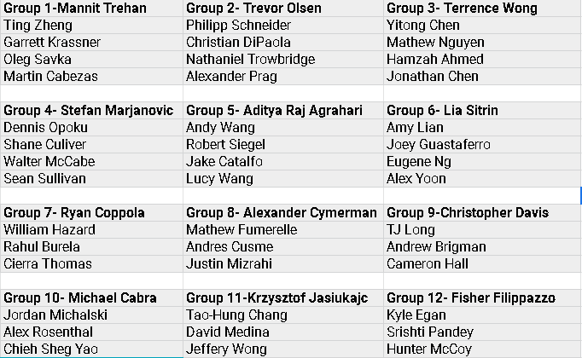
Group announcements

Slide 12
Reminder: Gregg Fisher- Thurs. March 4th
https://www.investopedia.com/trading/options-strategies/

Slide 13
THANK YOU FOR COMING!
Stay In Touch
IG & TWITTER: UBEQUITYRESEARCH

